Slide 1
Storefront Testing App
Final
CS 499 Group 4 “Bugs are Features Too”
Seanna Lea LoBue, Michael Murray, Eric Prewitt, Nicholas Wade, Kee West

Slide 2
Presentation Overview
Project Overview
Architecture
Plan vs Reality
Implementation
GUI, Database, Bug Creation, Bug Assignment, Design Decisions
Demo
Testing
Unit Testing, Acceptance, Findings
Issues
Metrics
Maintenance

Slide 3
Project Overview
Customer: Ben Fox - Trissential
Trissential: Software Quality Assurance
Needs
Create a functioning ecommerce webstore
Toggle the addition of bugs to the store
Admin can control bugs on a per-user basis
Easy to update (add new bugs)
Why?
Practice Automated Testing Scripts in a controlled environment
Evaluate employees
Demonstrate services to prospective clients

Slide 4
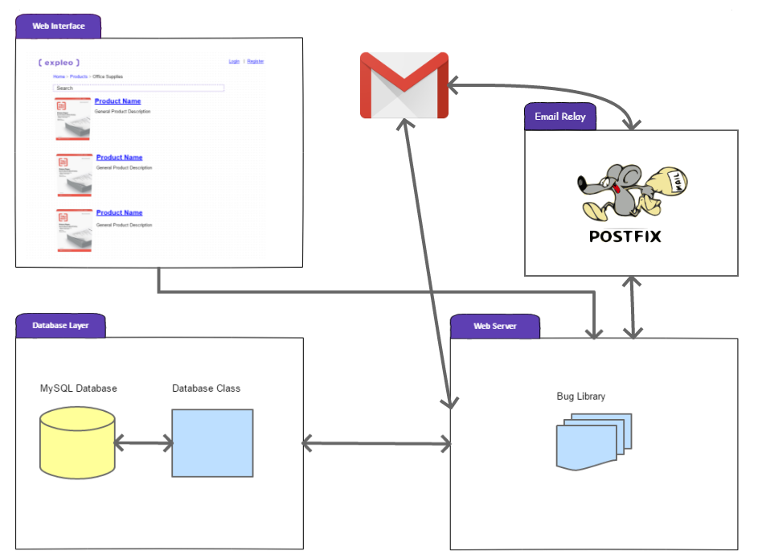
Architecture
Comprised of three major components
Web Server with Bug Library
Storefront Web Content
Database Interface
Changes to initial plan
Email relay
Gmail Account

Slide 5
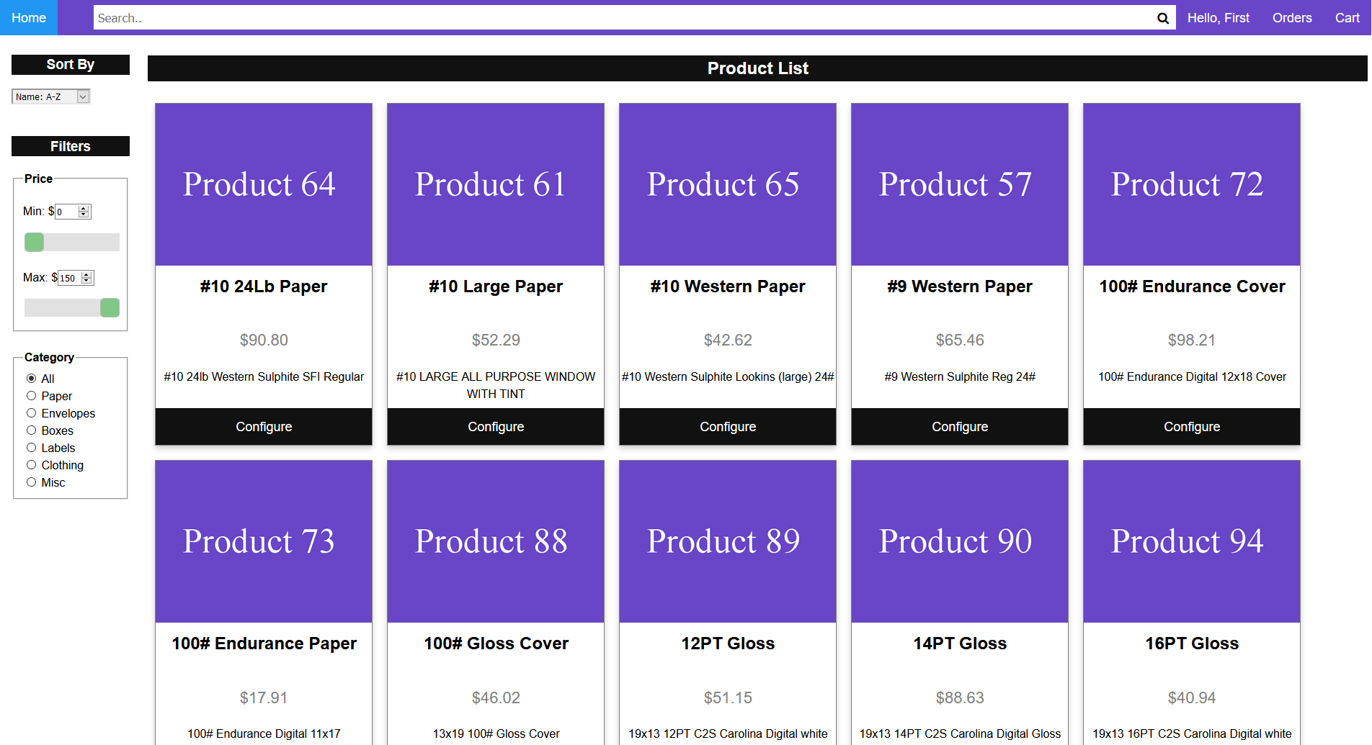
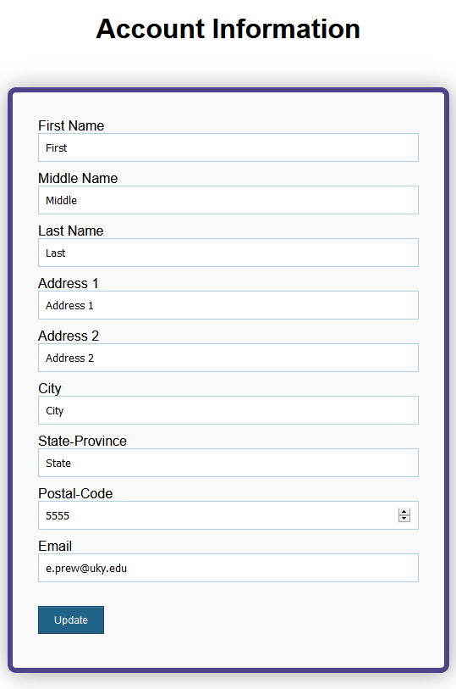
Implementation - GUI

Slide 6
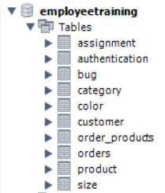
Implementation - Database
Default table set up and initial population is done through the buildDatabase function.
Once buildDatabase is complete, the user is redirected to login.
Main changes from initial architecture were to add or alter datatype of columns

Slide 7
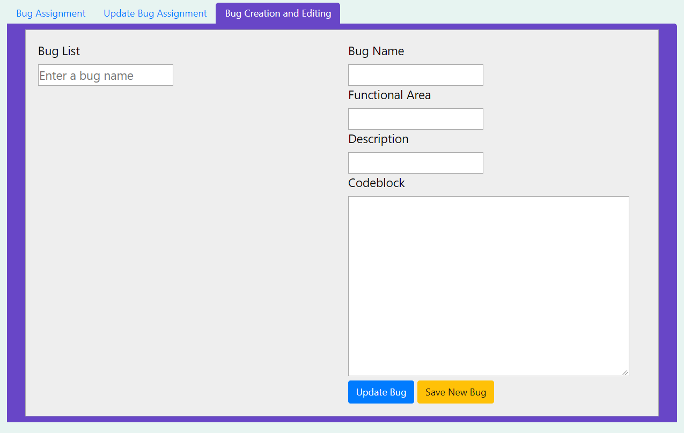
Implementation - Bug Creation
Select bug to populate existing bug data.
Either Save New Bug or Update Bug to database.
Edit PHP file to place new bug toggle.

Slide 8
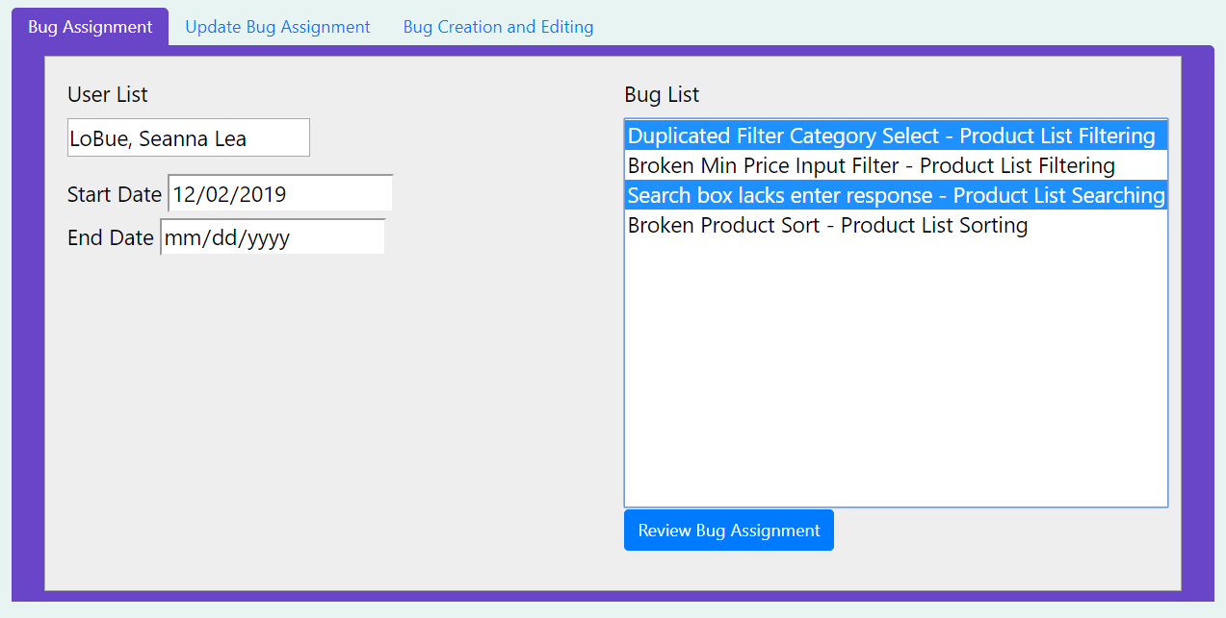
Implementation - Bug Assignment
Users and bugs are populated from database.
Review Bug Assignment displays user and selected bugs.
Button toggles to Save and allows saving to database.
Update tab allows changes to start and end dates and deletion of bug assignments.

Slide 9

Demo
Live demo: http://memu225.cs.uky.edu/cs499/StorefrontTestingApp/login.php
Demo video: https://www.youtube.com/watch?v=zCwRGG9yVG4

Slide 10
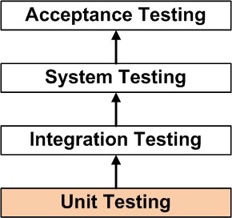
Testing - Unit
Test Individual Components
Initial Page Creation, Account Creation...
Ensure Core Functionalities
Account Page = Account Page
Test Page Features
Sliders, Dropdowns, Product Options...
Track Project Progression
Performed Throughout Development
Pass/Fail
Address Code Changes Where Needed

Slide 11
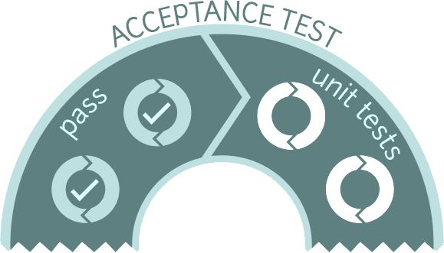
Testing - Acceptance
Ensure Product Meets Customer Needs
Desired Functionalities, Aesthetic…
Prepare Deliverable Product
Ensure Product Transparency
Code Comments, Client Understanding...
Pass/Fail
Address Code Changes Where Needed

Slide 12
Testing - Fixed Defects
Email verification does not link to final address
Number format is not properly enforced in price display in checkout.php
Receipt page formatting
User could login without completing email verification
JS addAttribute not an accepted function
Long bug names - functional area exceed the admin panel display size
Missing ids on admin page

Slide 13
Outstanding Defects
Shipping speed attribute does not exist in the database, as such, there is no way to view that information in past orders
Host server instabilities causing issues with non-ssh connections
MySQL password is occasionally not accepted, resolved by a server restart.
Input to order such as shipping address is allowed to be blank
Updating cart does not ensure quantity is valid within stock limitations
Placing an order does not deduct from product stock

Slide 14
Metrics
Story Points
Completed 84 of the planned 90 story points.
Actual Lines of Code
Approximately 2,700 lines of code.
Module Complexity
Average Complexity per LLOC of 0.21.
Average Complexity per Method of 2.50 (Min: 1, Max: 14).
None of our modules are explicitly coupled.
System Complexity
None of our classes are explicitly coupled.
Each of our pages are functionally independent from one another.
All page interactions via get/post submissions or by accessing a shared database.

Slide 15
Maintenance
General updateability
Most web pages function in isolation (occasional auxiliary php file called by AJAX)
Low cyclomatic complexity and no coupling
Easy to add new pages
Little to no need for direct page interaction, mostly rely on database
Highly reused code like the header is separate and can be included directly
Adding new bugs
Admin page helps to review and configure new bugs
Source code alterations for adding bugs is simple
Administrator manual contains templates to help with making bugs
No inherent bugs per page limitations

Slide 16
Lessons Learned
Clearly defined goals allows for easier division of labor
Goals were defined early and thoroughly in this project which helped
Importance of a design priority hierarchy
By having this priority, even the face of setbacks, we can deliver a finished product
Frequent testing is important
We found many bugs early, preventing them from cascading later
As personal responsibilities grow, scheduling can become difficult
Making good use of days where we were not required to attend CS499 made for an easy time we could all ensure we were available

Slide 17
Closing Comments
Architecture didn't need to change noticeably
Implementation is modular and easy to update
Product testing mimics the planned customer use
Addressed core customer goal of making adding bugs easier
Accomplished all major user stories

Slide 18

Questions?

